Slide 1
Software Evolution
Maintenance Request Evolution
Bug Tracking Tools

Slide 2
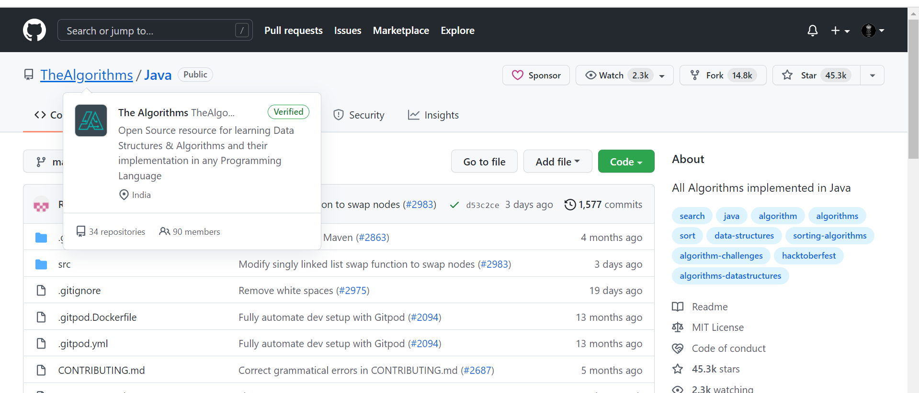
Maintenance Request Evolution
https://github.com/TheAlgorithms/Java

Slide 3

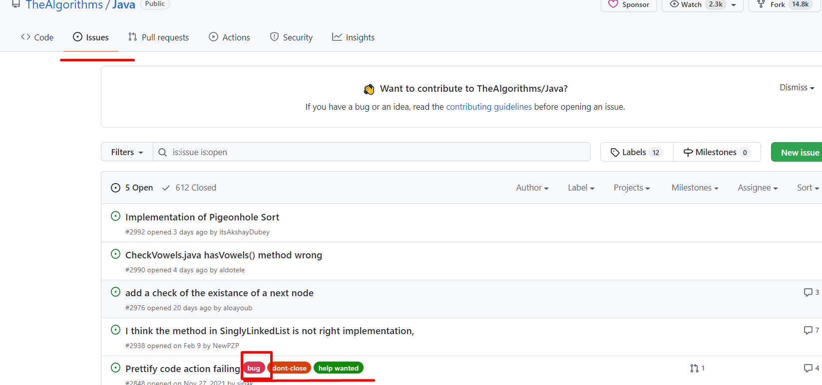
Maintenance Request Evolution

Slide 4
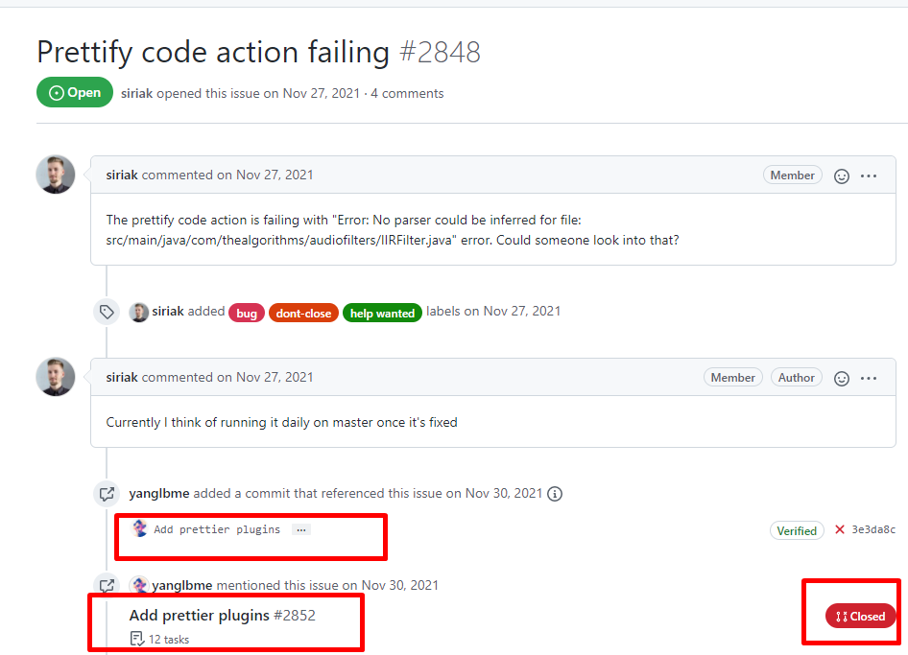
Maintenance Request Evolution

Slide 5
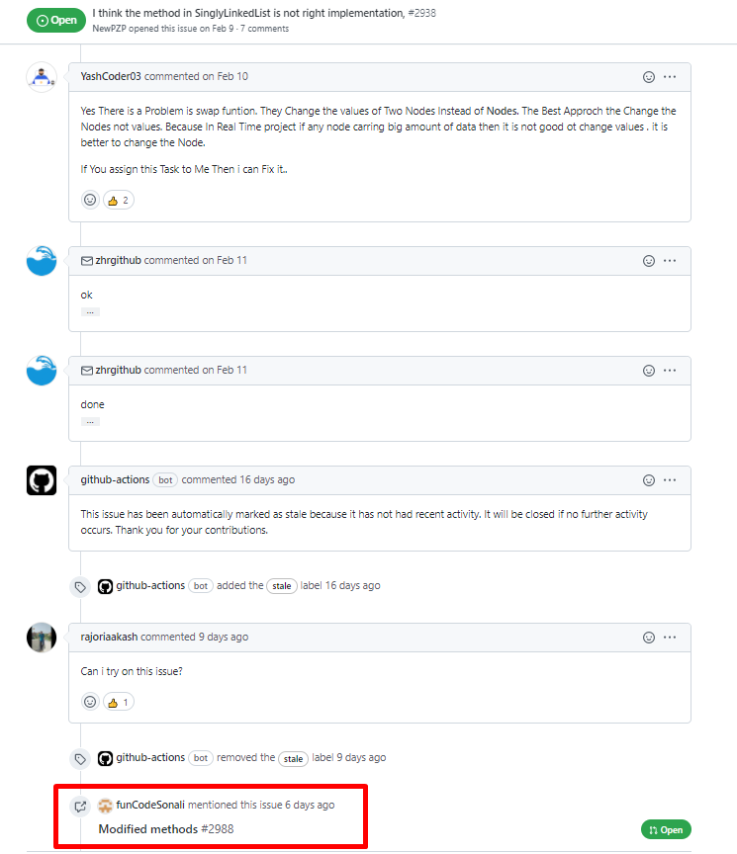
Maintenance Request Evolution

Slide 6
Bug Tracking Tools
What is bug tracking?
Bug tracking is the process of logging and monitoring bugs or errors during software testing. Large systems may have hundreds or thousands of defects. Each needs to be evaluated, monitored and prioritized for debugging. In some cases, bugs may need to be tracked over a long period of time.

Slide 7
Bug Tracking Tools
How bug tracking works ?
A software bug occurs when an application or program doesn’t work the way it is designed to function. Testing teams use bug tracking to monitor and report on errors that occur as an application is developed and tested.
“A major component of a bug tracking system is a database that records facts about known bugs,” says Wikipedia.

Slide 8
Bug Tracking Tools
During its lifetime, a single defect may go through several stages or states. They include:
  Active: Investigation is underway
  Test: Fixed and ready for testing
  Verified: Retested and verified by quality assurance (QA)
  Closed: Can be closed after QA retesting or if it is not considered to be a defect
  Reopened: Not fixed and reactivated

Slide 9
Bug Tracking Tools
Why bug tracking is important ?
It is estimated that software developers make 100 to 150 errors for every thousand lines of code. relatively small application of 20,000 lines of code will have roughly 200 serious coding errors
Integrating bug tracking into the testing workflow improves efficiency by helping testers prioritize, monitor and report on the status of each error.

Slide 10
Bug Tracking Tools
Severity levels
  Catastrophic: Causes total failure of the software or unrecoverable data loss. There is no workaround and the product can’t be released.
  Impaired functionality: A workaround may exist, but it is unsatisfactory. The software can’t be released.
  Failure of non-critical systems: A reasonably satisfactory workaround exists. The product may be released, if the bug is documented.
  Very minor: There is a workaround, or the issue can be ignored. It does not impact a product release.

Slide 11
Bug Tracking Tools
Severity levels
  Catastrophic: Causes total failure of the software or unrecoverable data loss. There is no workaround and the product can’t be released.
  Impaired functionality: A workaround may exist, but it is unsatisfactory. The software can’t be released.
  Failure of non-critical systems: A reasonably satisfactory workaround exists. The product may be released, if the bug is documented.
  Very minor: There is a workaround, or the issue can be ignored. It does not impact a product release.

Slide 12
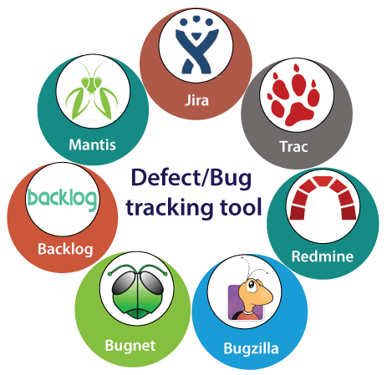
Bug Tracking Tools

Slide 13

Bugzilla
What is Bugzilla?
  Web-based bug tracking tool
  Open-source tool
  Support various systems such as Windows, Linux and Mac

Slide 14
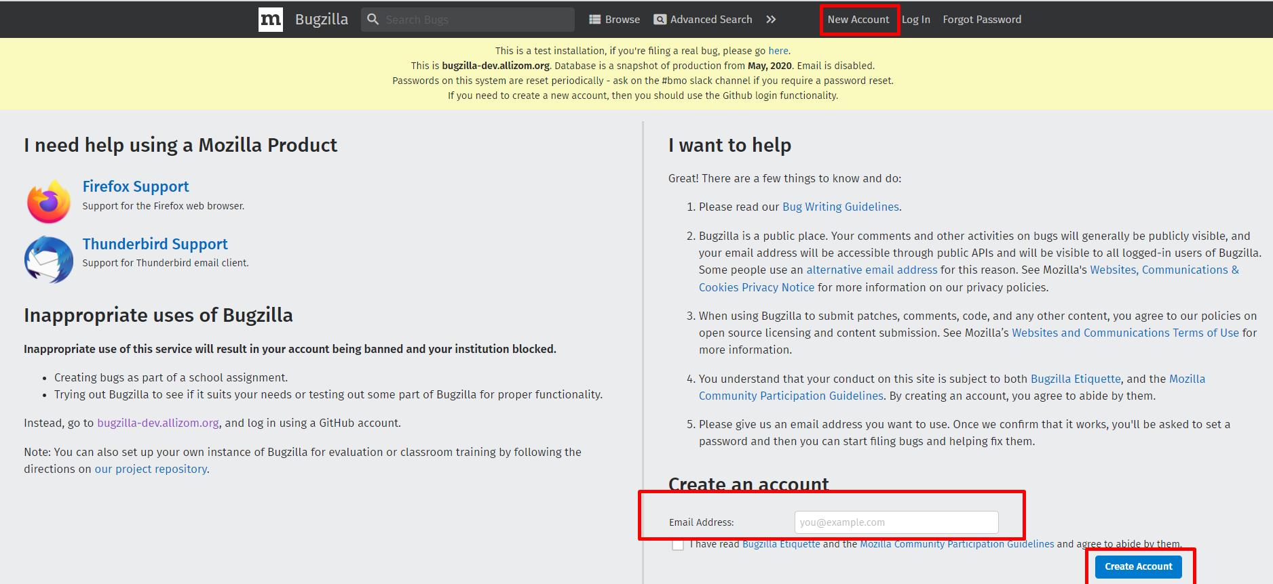
Create New Account
(Bugzilla for Mozilla products)

Slide 15
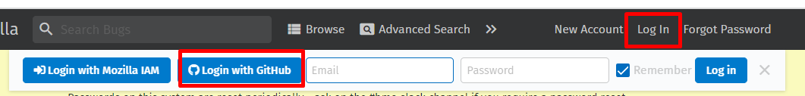
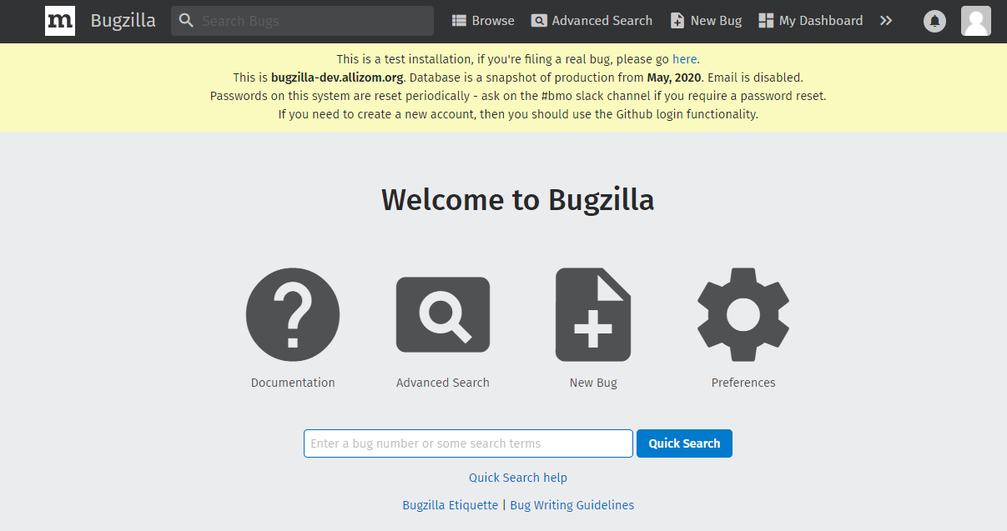
Login With Github

Slide 16
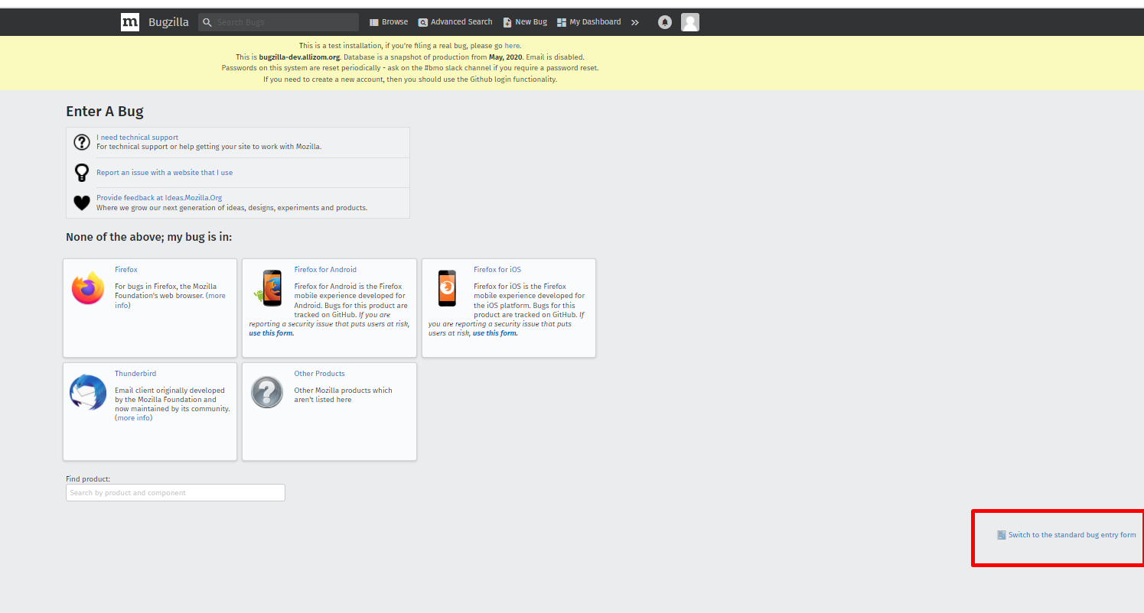
Add New Bug

Slide 17
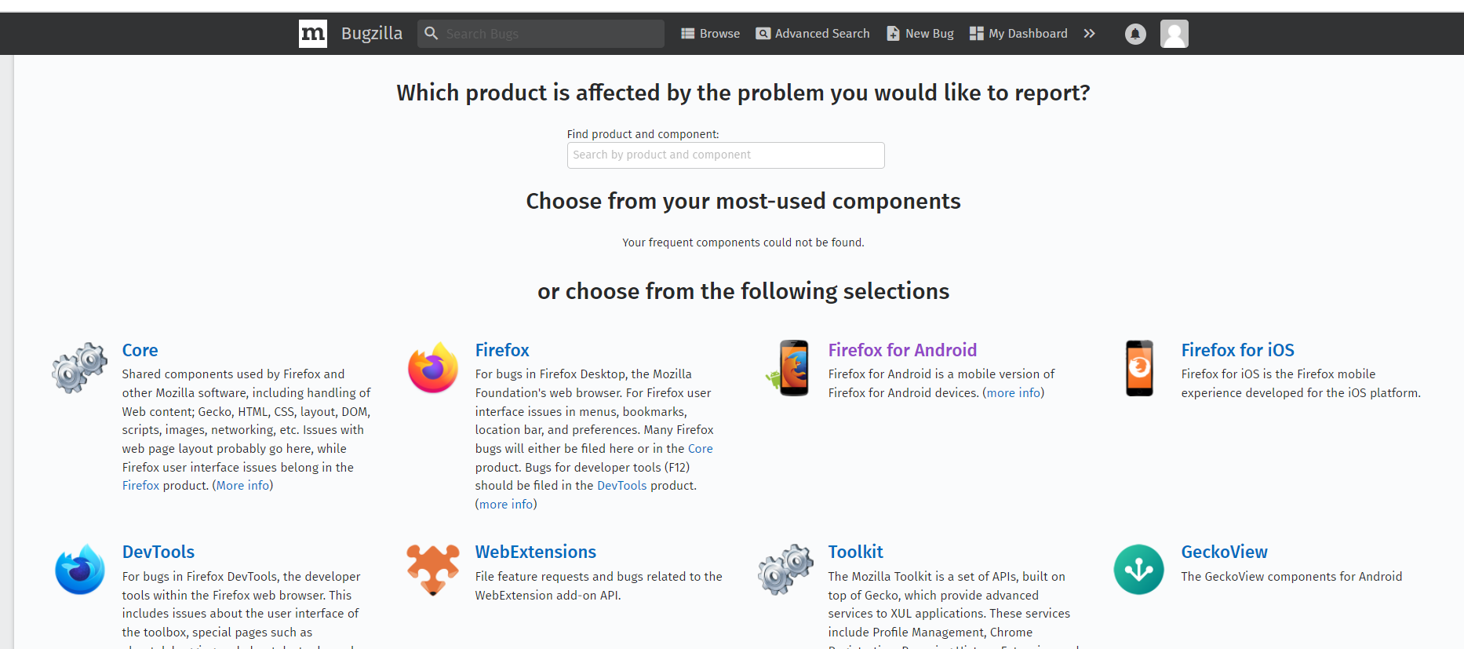
Select Product

Slide 18
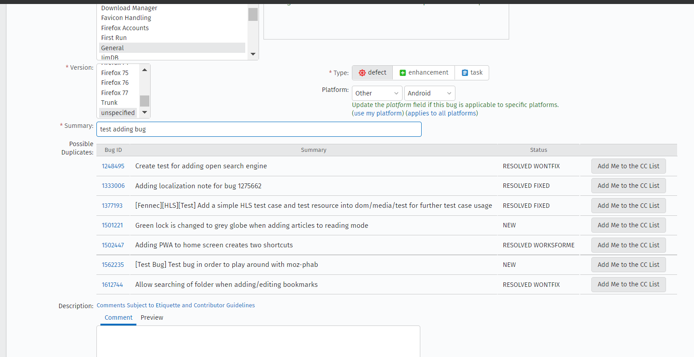
Bug Details

Slide 19
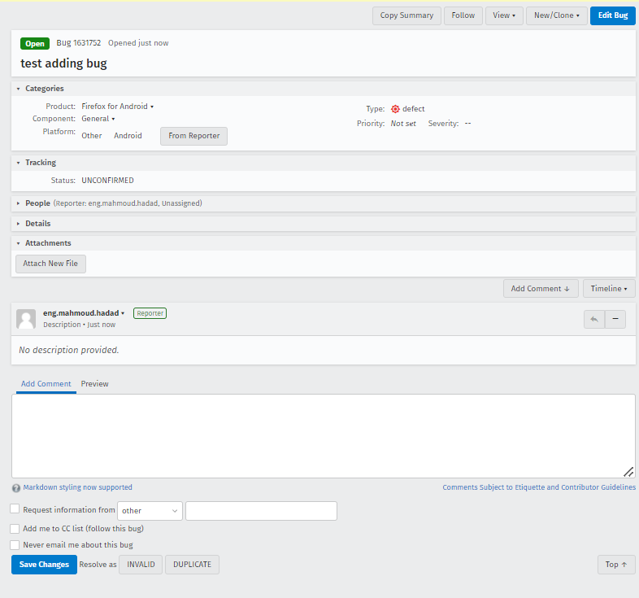

Slide 20
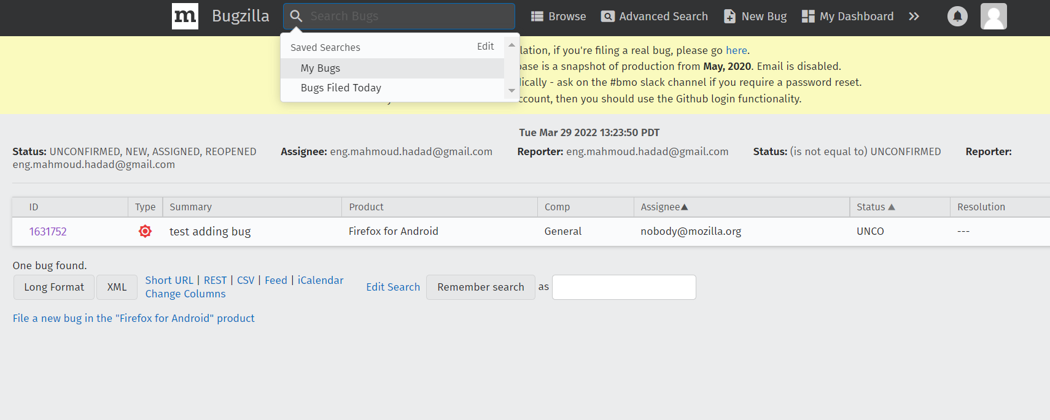
Searching Bugs

Slide 21
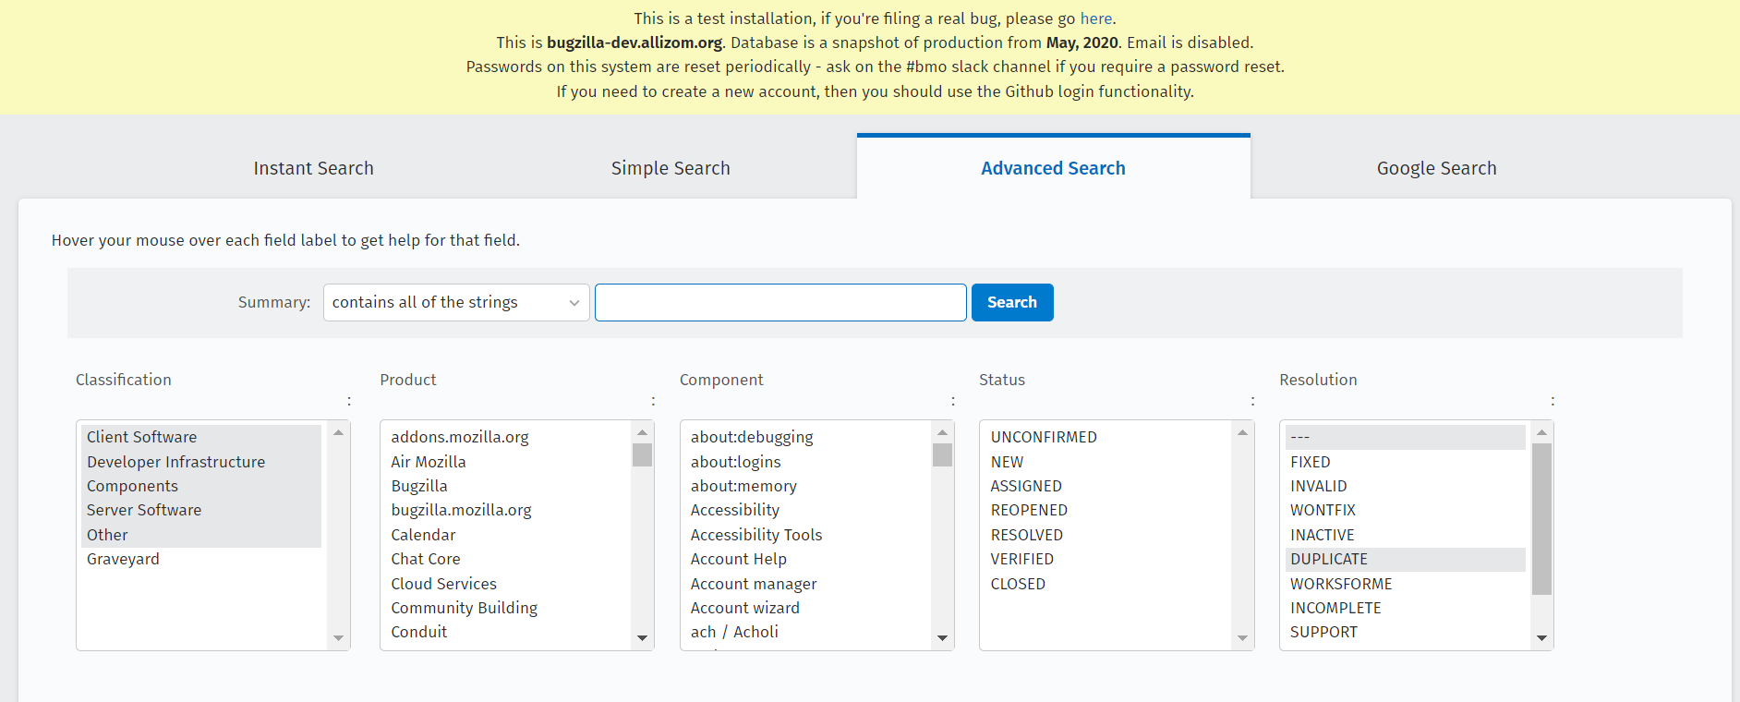
Advanced Search

Slide 22
References
https://www.ibm.com/topics/bug-tracking
https://www.youtube.com/watch?v=J7g1_VOOUz0
https://bugzilla-dev.allizom.org/

Slide 23
Questions

